Slide 1
2D Transformation

Slide 2
2D Transformation
2D transformation consist of :
Translation
Rotation
Scaling
Translate
Rotation
Scaling

Slide 3
2D Transformation
glTranslate{fd}( X , Y , Z )
gl.glTranslated( 50 , 0 , 0 )
glRotate{fd}(angle, X , Y , Z )
gl.glRotated( 45 , 1 , 0 , 0 )
glScale{fd}( X , Y , Z )
gl.glScaled( 2 , 2 , 1)

Slide 4
2D Transformation
If we have more than one transformation we need PushMatrix() and PopMatrix() command to separate them.
PushMatrix() use to hold the matrix of bellow in a top stack.
PopMatrix() use to retrieve the matrix of top in a stack.

Slide 5
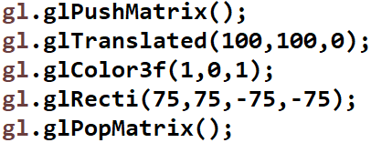
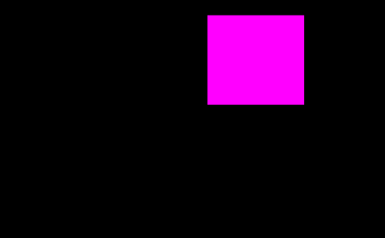
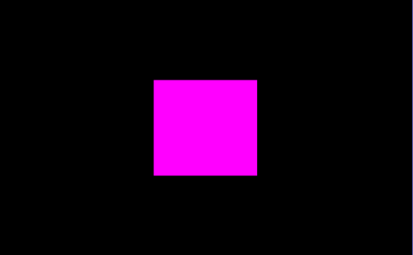
Translation XE

Slide 6
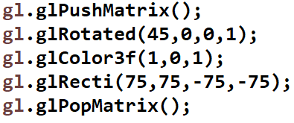
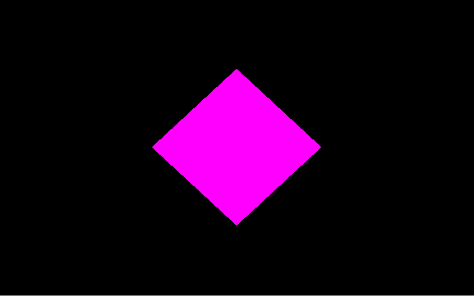
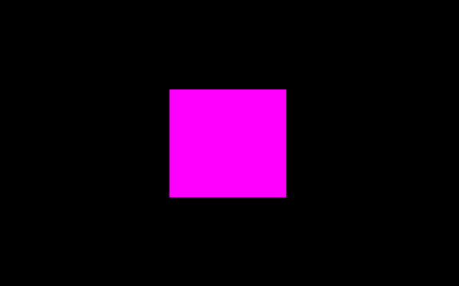
Rotation XE

Slide 7
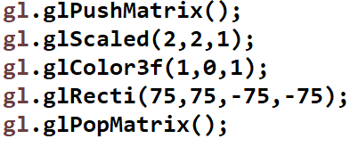
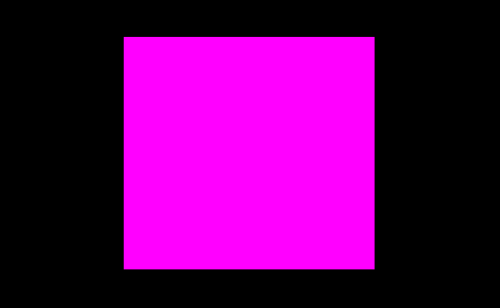
Scaling XE

Slide 8

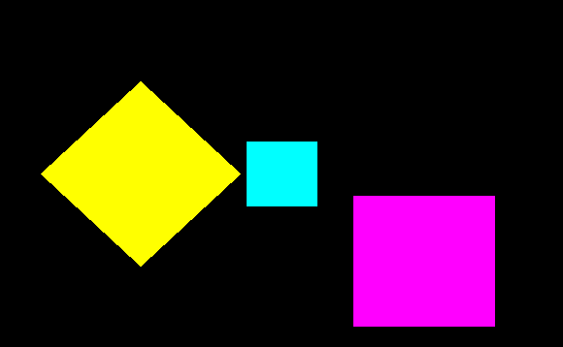
Class Activity

Slide 9
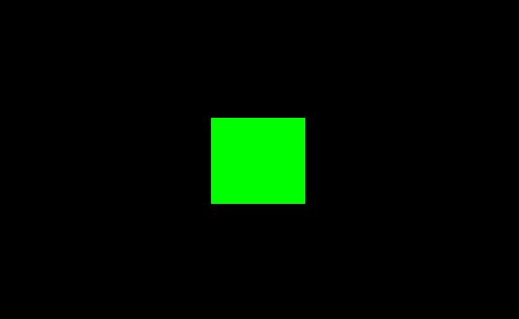
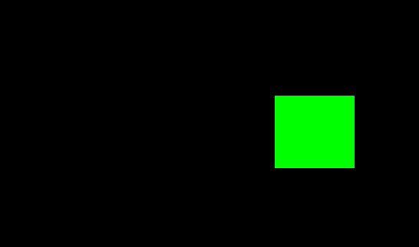
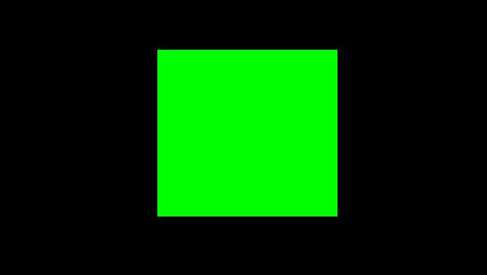
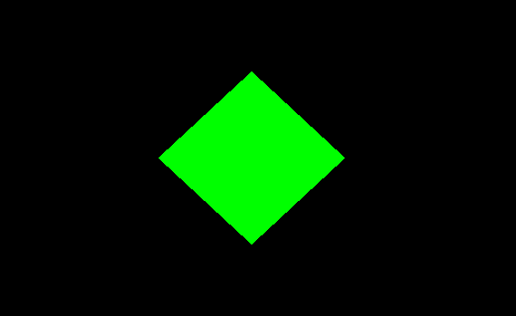
Class Activity
Translate (t)
Scale
(s)
Rotate
( r )

Slide 10
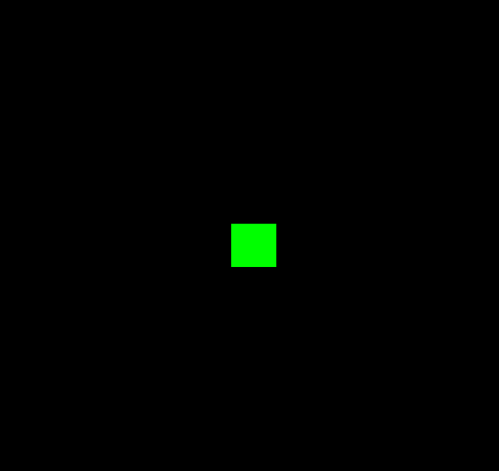
Activity 1
Use 3 keys: x,y and s
X: to translate on the x-axis.
Y: to translate on the y-axis.
S: to stop translate, and stay the shape in the center point.

Slide 11
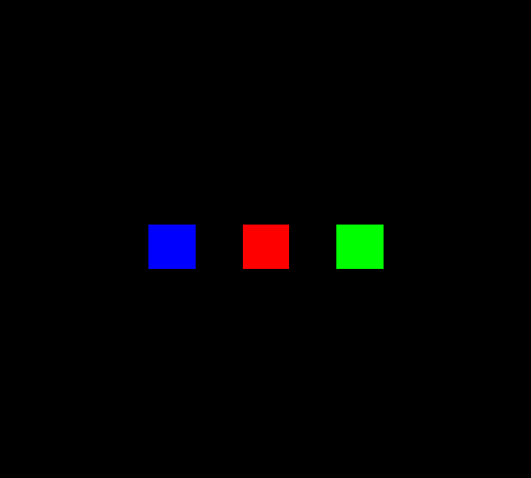
Activity 2
Use 3 keys: r, g and b
r: to translate red shape on he y-axis.
g: to translate green shape on he y-axis.
b: to translate blue shape on the y-axis.
Finally, use exit mouse to reload the shapes

Slide 12
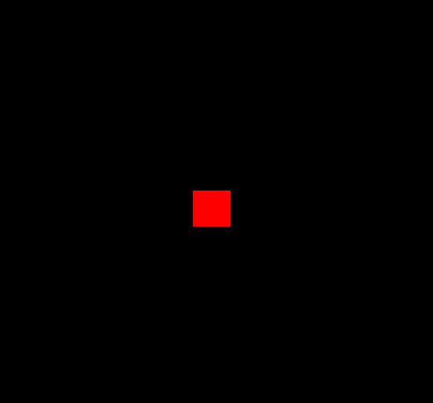
Activity 3
Use 3 keys: t, r and s
t: to translate the shape on he x-axis.
r: to rotate the shape continually around the original point.
s: to scale the shape in the center point.
Finally, use exit mouse to reload the shape

